Slide 1

Credit One Project
CARLOS E PENA
Data Scientist

Slide 2
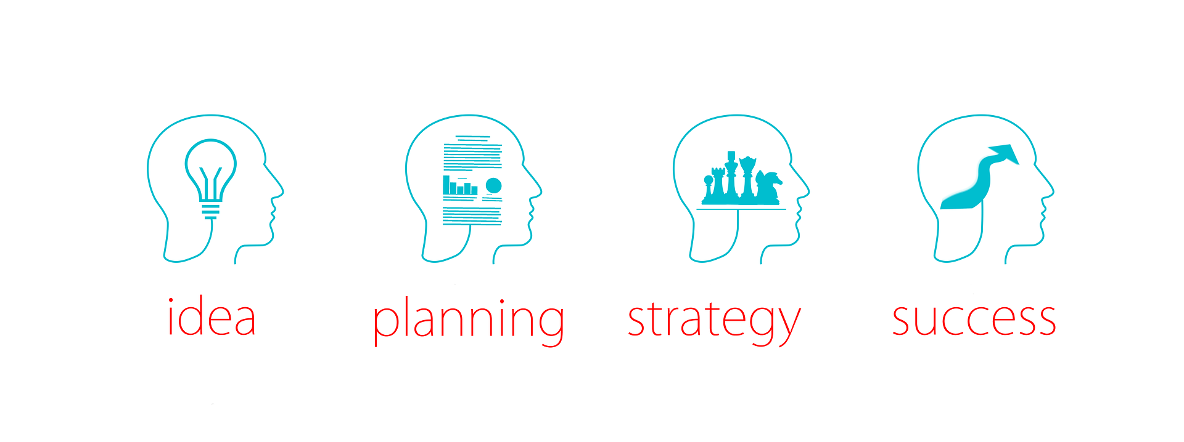

Define the Goal
Credit One is at risk of losing business because its credit score service is getting less effective:
Increase of customers who have defaulted on loans
Credit One needs to improve its understanding on how much credit is allowed to someone to use.

Slide 3
Data Science Framework
The framework to be followed for this project will be (BADIR):
From clear understanding of the issue to the recommendations, following step by step
1.
Business Question
2.
Analysis Plan
3.
Data Collection
4.
Build Model /
Derive Insights
5.
Recommendations

Slide 4

Collect Data
Historical data has been collected:
Amount of the given credit, between $10K and $1,000K
Gender, 60% female – 40% male
Education, High school, University, Graduated school and other
Marital Status, married, single, divorce, other
Age, goes from 21 to 79 years old
History of past payments
Amount of previous payment
Customer behavior, default and not default

Slide 5
Manage Data
Data is in well shape although some work need to be done:
Check on missing data
Handling inconsistent data
Delete duplications
Data reduction
Check relationship between data

Slide 6

Potential issues with Data
There are some concerns with the given data:
Relationship between variables
Information need to be numeric, therefore some text data need to be changed
Too much data
What information will be meaningful for the analysis

Slide 7

Initial Insights
Glean from quick look at the data:
Divorce people is less likely to default
People less than 30 years old, high school degree with high amount of credit
Customer behavior, 22% of people expected to default
From those 22%, 55% has a credit lower or equal to $100K and 37% lower or equal than $50K

